Slide 1
KBSI steering committee
28 October 2021
Dr Jeremie Pelletier

Slide 2
Summary KUTC facility in KU
Steps | Location | Description | Status
Office | SAN > 8 > 8377A | Office room for 6 desks. Identical to the one in Masdar | Ready
Office Director | SAN > 8 > 345D | Separate office requested. | Ongoing with FM
Laboratory | SAN > 8 > 8022 | Laboratory including the equipment and the facilities submitted by Pr Choi | Available by December 2021
Research equipment support plan | Masdar | Expert for Electron Microscope or Clean room most Relevant from now to Q1 2022 Expert for XPS in Q1 2022 | Start by end of Q4 2022

Slide 3
Relocation impact on CORE lab Operation
2021
2022
 | Sep | Oct | Nov | Dec | Q1 | Q2 | Q3 | Q4 | Status for Q4 2021 –Q1 2022 for KBSI/KU collab
ACBC |  | No Operation |  | Partial reopening of 8019 & 8021 | Partial reopening of 8019 & 8021 | Complete reopening
Clean Room |  |  |  |  |  |  |  |  | High interest
Electron Microscopy |  |  |  |  |  |  |  |  | High interest
Solar Device Characterization |  | No Operation | Partial Reopening in 8020 | Partial Reopening in 8020 | Complete reopening |  |  |  | Not available
Material Testing |  | No Operation |  | Relocation of items in storage /installation | Partial reopening /installation | Complete reopening |  |  | Not available
Research Laboratory Workshop and prototyping |  |  |  |  |  |  |  |  | Low interest
Advanced Manufacturing |  |  |  |  |  |  |  |  | Low interest
Retrofitting in Arzanah is still ongoing (Q4 2021)
No operation | 3
Partial operation | 0
Normal Operation | 4

Slide 4
KUTC lab (SAN > 8 > 8022)
· Size : 100 m² area available for chemical synthesis under constant temperature and humidity environment for about 3 researchers.
· Experiment : Chemical synthesis, Wet chemistry work, Bio & Materials pre-treatment,
Simple characterization, Post-treatment, Refining, Washing.
· Component : Table (Chair), Air conditioning system (Temperature, humidity control),
Water supply (Water sink), Gas (Ar, N₂) supply.
List of equipment (To be purchased by KBSI)
 | Equipment | Purpose
① | Drying oven | Material drying for pre-treatment
② | Tube furnace | Chemical reaction, Calcination
③ | Air conditioning system | Maintain constant temperature and humidity of total lab space
④ | Water sink | Chemical washing, Refining during post-treatment
⑤ | Synthesis working table | Balances, Hot plate & magnetic stirrer, Ultrasonic cleaner, pH meters, Vortex mixer
⑥ | Chemical cabinet | Temperature, Fume extraction, Filtering storage of acid(&base), Corrosive and flammable material
⑦ | Deionized water system | Chemical washing, Refining during post-treatment
⑧ | Centrifuge system
⑨ | Fume hood | Fume extraction during chemical synthesis
⑩ | Glove box | Controlling chamber for constant temperature, humidity, vacuum
12 m
①
Drying
oven
②
Tube
furnace
③
Air conditioning system
⑨
Fume hood
0.8 m
0.8 m
0.8 m
2 m
1.5 m
1.5 m
1.5 m
1 m
④
Water
sink
⑤
Synthesis working table
8 m
1.5 m
1.5 m
⑩
Glove box
1 m
3 m
2.5 m
⑥
Chemical
cabinet
⑦
Deionized water system
⑧
Centrifuge
system
0.8 m
0.8 m
0.8 m
1 m
2 m
1 m
1 m

Slide 5
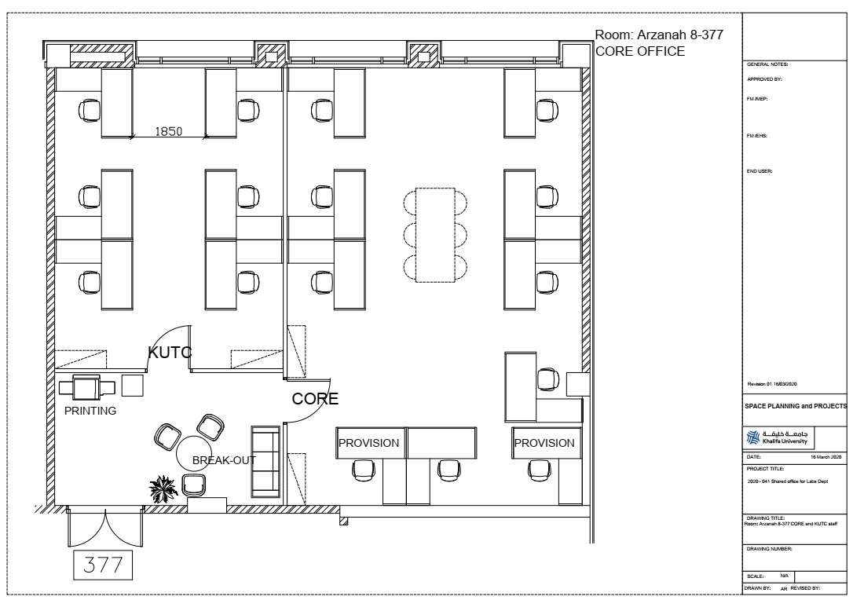
KUTC Offices
KUTC Team Offices
6 workbenches in separate room

